Slide 1

Student, Transferee Enrollment Processing System
Lauren Brian L. Sy
Rian Christopher F. Segarra
Ronnelo A. Mernilo

Slide 2

DO YOU KNOW?

Slide 3



P R O B L E M
#TransfereeProblems
#FreshmenProblems

Slide 4

S O L U T I O N

Slide 5


S O L U T I O N

Slide 6

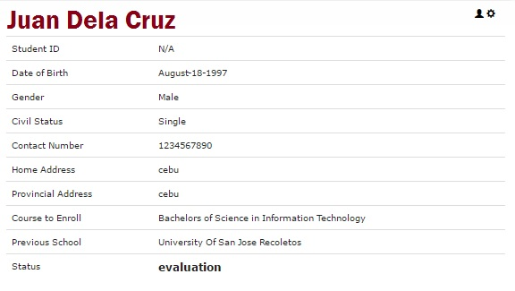
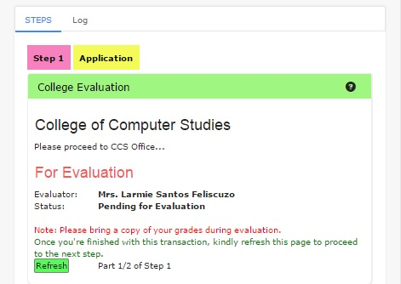
F E A T U R E S

Slide 7


F E A T U R E S

Slide 8





REQUIREMENTS

Slide 9


B E N E F I T S
=

Slide 10
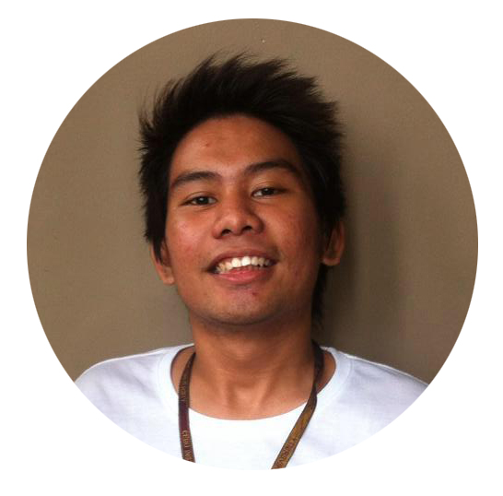
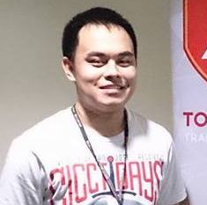

Rian Christopher F. Segarra
BSIT - 4
Lauren Brian L. Sy
BSIT - 4
Ronnelo A. Mernilo
BSIT - 4

Slide 11


